Slide 1

League of Legends
Insights to Reach the Top
Using Data Science Techniques
Henry Lee
July 17, 2018

Slide 2
Insights Through
Each Data Science Step
LOGISTIC REGRESSION
4
3
INFERENTIAL
STATISTICS
2
EXPLORATORY
DATA
ANALYSIS
1
DATA
WRANGLING

Slide 3
1
REST API
Extract data from League of Legends Site
-------------
2
Join Data
Make use of multiple datasets
DATA WRANGLING
-------------
3
Union Data
Further complete each dataset
-------------
Renaming
Rename to clarify understanding of dataset
4
-------------
5
Converting / Reindexing
Manipulate dataset to prepare for analysis
-------------

Slide 4
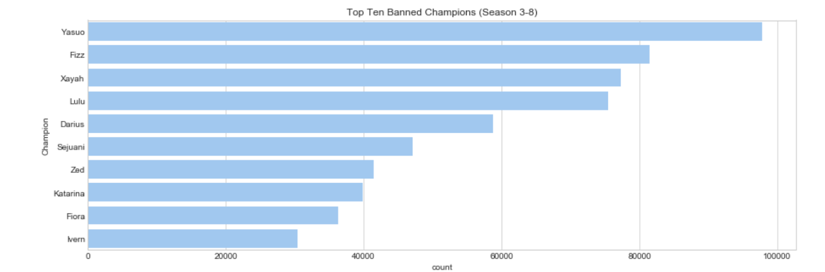
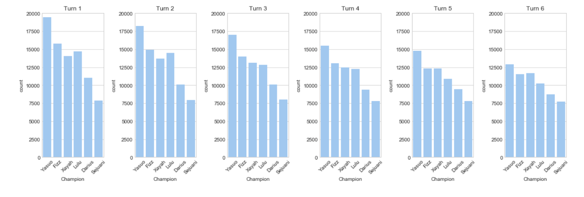
Exploratory Data Analysis
1
Insight 1
Top 6 Bans for Each Turn for the past 5 Seasons are the same in the exact same order
Action:
Optimize time and efficiency by practicing/mastering champions not listed

Slide 5
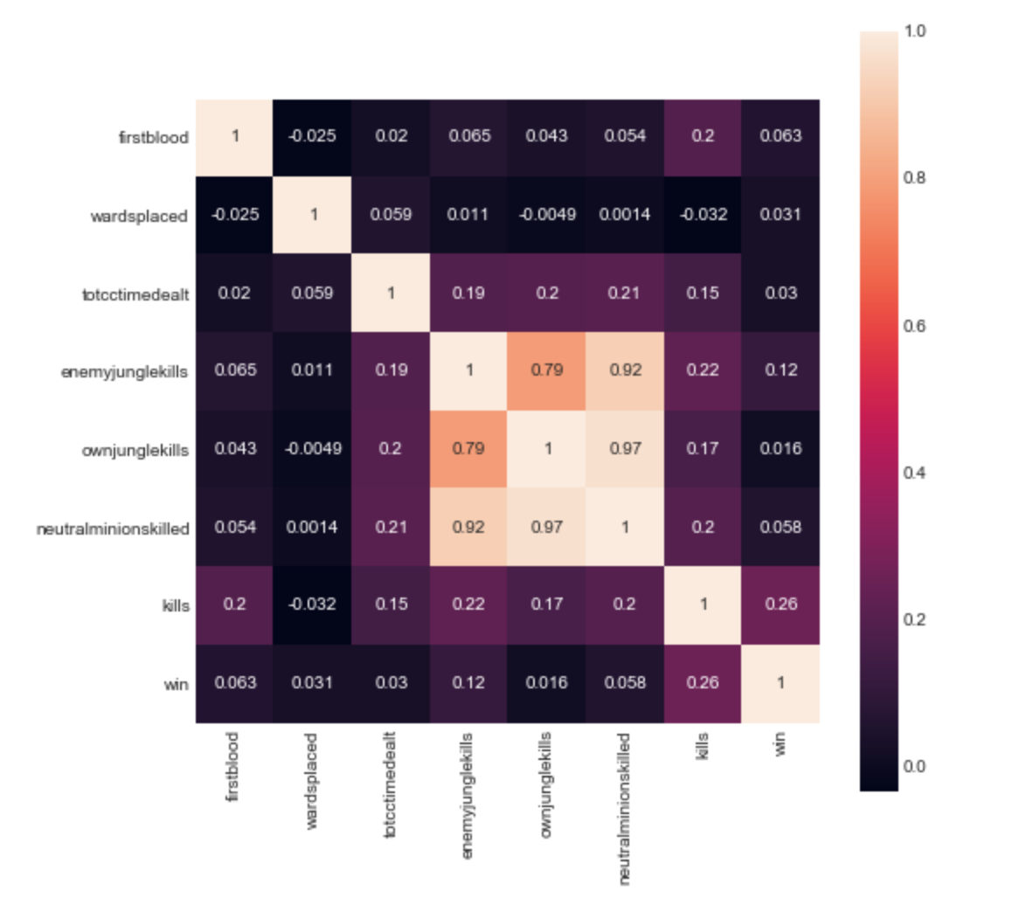
Exploratory Data Analysis
2
Insight 2
Micro variables have a very low correlation w/ winning
Action:
Understand which champions/strategies are the strongest to capitalize on current meta

Slide 6
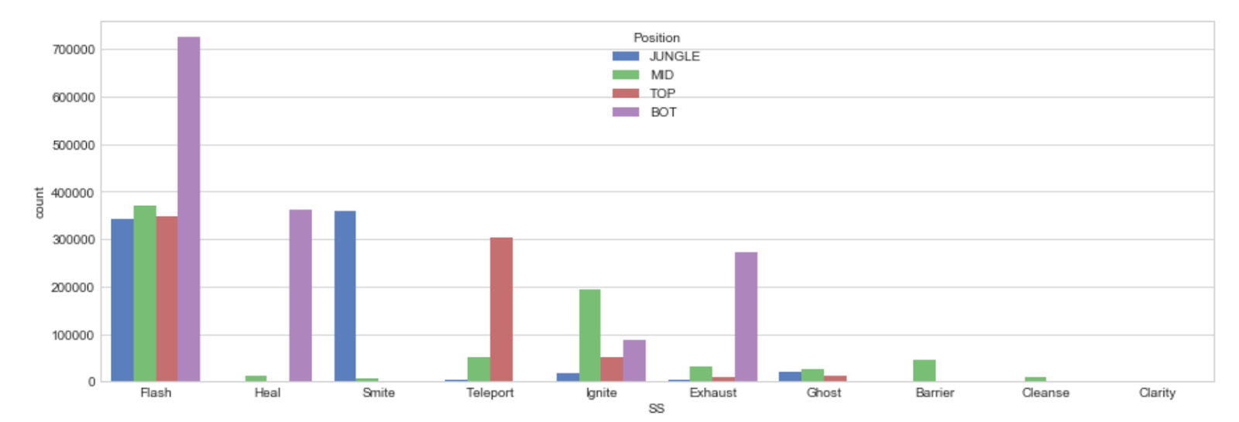
Exploratory Data Analysis
3
Insight 3
Within each role, there are summoner spells that are taken majority of the time
Action:
Either follow the meta or use this to counter enemy laner’s summoner spell

Slide 7
Inferential Statistics
Tested if the proportion of wins on the blue side is equal to the proportion of wins on the purple side.
two sample z-test on the difference between our sample proportions
99% confidence interval 0.005 and 0.021
Actions:
This may be something just to linger in the back of your head. Nothing to take into considerable weight when deciding whether to dodge a game or not.
Statistical Significance: Yes
Practical Significance: No

Slide 8
Logistic Regression Model
Predict which teams are more likely to win and which variables have more weight on accurately predicting wins
Applied both L1 and L2 models to each feature reduction below
Used accuracy as our score
1. Remove fields unrelated to focus/Remove duplicate Fields
Conclusion:
Using our first model, we can focus strategies around tower kills, dragon/baron, inhibitors
2. Removed lurking variables on top of model 1
3. Account for Multicollinearity
Accuracy Score: 0.90
F1 Score: 0.90
Accuracy Score: 0.89
F1 Score: 0.89
Accuracy Score: 0.88
F1 Score: 0.88

Slide 9
Final Thoughts

